Slide 1
Workshop Guide
Qatar Leadership Conference

Slide 2
The Hague International Model United Nations Regional Office in Qatar (THIMUN Qatar)
In 1968, Mr. Paul Sand from The American School of The Hague organized the first Model United Nations in The Hague. In 1981 the THIMUN Foundation was established and is today directed by a Board of Directors consisting of teachers from international and Dutch schools in the Hague area. The THIMUN offices in The Hague and in Qatar are permanently staffed, and THIMUN Qatar is in its ninth year.
In 1995 the THIMUN Foundation was accredited as a Non-Governmental Organisation (NGO) associated with the United Nations Department of Public Information. 2001 saw the first annual session of the THIMUN Youth Assembly. In 2003 the THIMUN Foundation was granted Roster Consultative Status with the United Nations Economic and Social Council.

Slide 3
The THIMUN Qatar office
The THIMUN Qatar office has three members; Ms. Fatima El Mahdi, Head of Program, Ms. Amina Hassan, Conference Coordinator and Mr. Sakib Mahmoud, Conference Specialist. The office is supported by the THIMUN Qatar Advisory Board consisting from key schools in the region.
The office runs 4 International Conferences;
THIMUN Qatar Model United Nations Conference run annually each January with 2000 high school students from 16 countries gathering to debate global issues on the agenda in simulated UN sessions
The Middle School Model United Nations Conference in Qatar run annually each March, with 500 middle school students from 5 countries gathering to debate an amended list of global issues on the agenda using THIMUN rules of procedure
The THIMUN Qatar Leadership Conference run annually each October with 900 students from 8 countries gathering to build skills and knowledge that reflect the agenda of the THIMUN Qatar Model United Nations Conference
The Arabic Model United Nations Conference run annually each November with 150 high school students from 3 countries gathering to debate global issues on the agenda to debate global issues in Arabic.

Slide 4
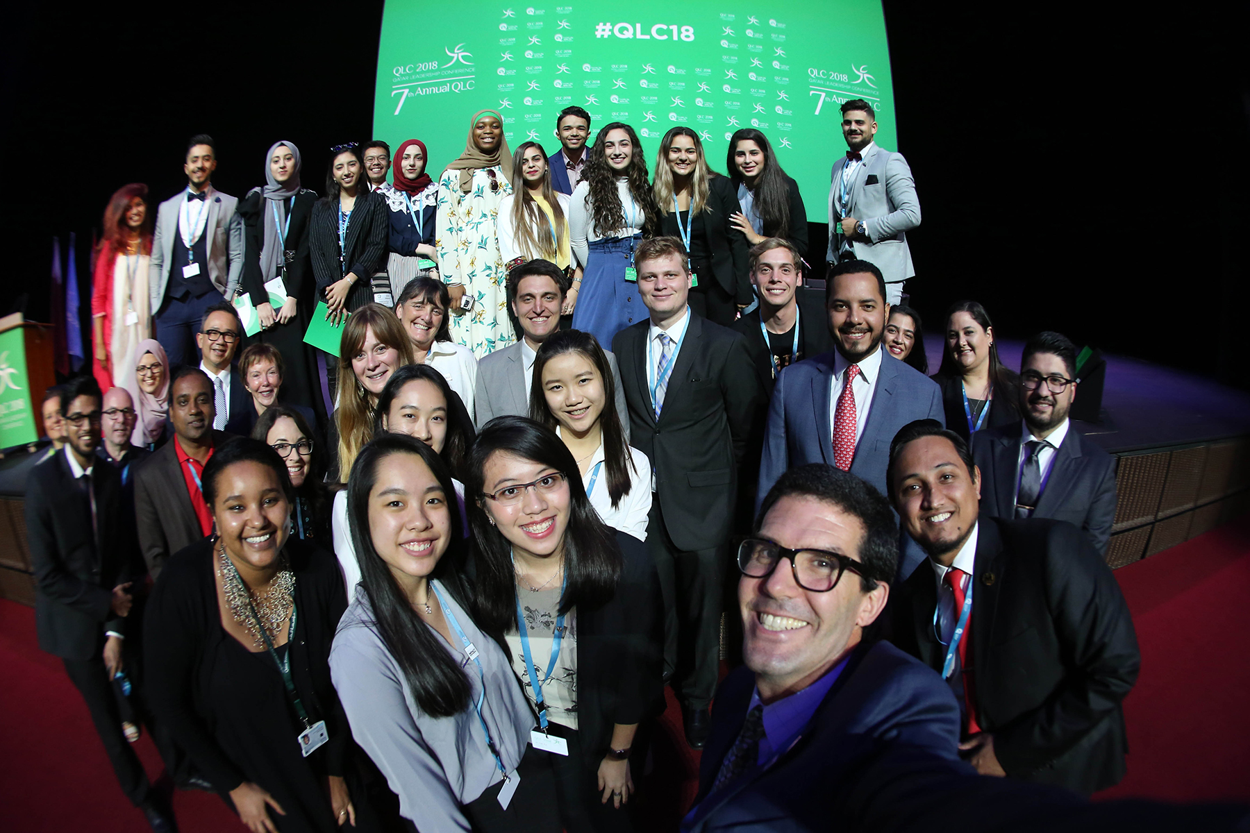
What is the Qatar Leadership Conference?
This annual event was established in 2011 by the THIMUN regional office in Qatar, under the patronage of H.E. Shaikh Mohammed bin Hamad Al Thani. The QLC is a student led, student centered youth leadership development platform, featuring student voice, highlighting local talent and international leaders, as well as the United Nations.

Slide 5
What does the conference look like?
QLC 2018 Conference Video

Slide 6
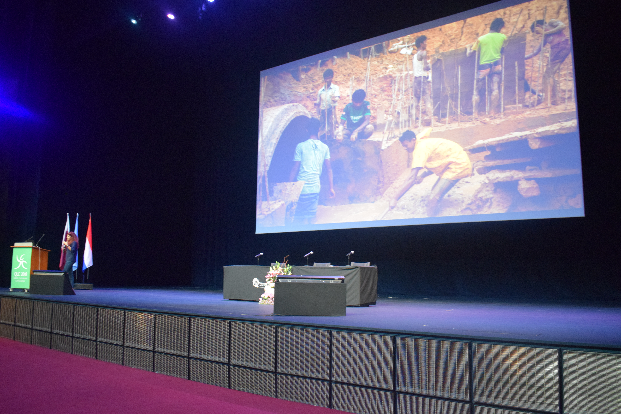
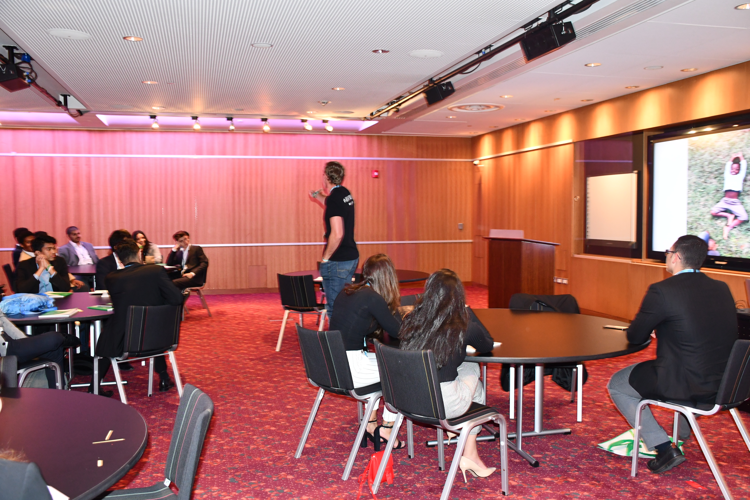
What does a workshop look like?
Some workshops are held in the main theatre and are capped at PAX 120. Sessions taking place in the theatre are expected to focus more on information sharing rather than skills building, whilst remaining interactive and engaging. Workshop outcomes are to expose students to a larger cause or global issue, with clear steps to engage students to follow through post workshop.
Some workshops are held in the meeting rooms and are capped at between PAX 40-70. Sessions taking place in the meeting rooms are expected to focus more on skills building. Workshop outcomes are to deliver three key outcomes for students, and to phrase open ended questions to leave space for student innovation.

Slide 7
Tech Specifications
Each meeting room has a large LCD screen
Your laptop will be set up on the podium by the screen
If you do not have a laptop, and have indicated so on the confirmation form, we will have one ready set up for you
Our office can connect HDMI, VGA and thunderbolt ports. If you have a different connector, please do let us know so that we have have the parts ready
The conference has WiFi, however we strongly recommend that you download any media needed for your presentation onto your laptop.

Slide 8
Who attends the workshops?
Each school in attendance runs a model united nations (MUN) club, led by high school students and supported by a staff MUN director. These high achieving student leaders are the main body of the student participants.
Each school also fields teacher chaperones as well as MUN Directors, adding a small mix of teachers to the workshop audience.
Finally, we encourage local adult presenters to spend the day and attend workshops, adding to the group of adults in attendance.

Slide 10
Students’ experience
Students attend 11 workshops during the conference
Students plan their workshop attendance based off of workshop synopses and bios provided by the presenters
There are 132 workshops available through the conference’s 2.5 day run

Slide 11
QLC strands
Communication | Diplomacy | Education | Entrepreneurship | Humanitarians | Leadership
Mental Health | Model UN | Social Issues | The SDGs | Film and Photography | Journalism
Each strand of the QLC is a category of workshop to help attendees to plan their conference attendance.

Slide 12
Student Leadership
Youth Leadership is a key element in the education of the next generation. In the communication age, global issues are subject to propaganda and misinformation to a global audience, focused on the development of our youth’s minds- polarizing vast global communities and exposure going to the loudest rather than the truest. The THIMUN Qatar Leadership Conference is unique in that it is student led and student centered, allowing students to select the type of workshops and leaders that they want to work with, and with workshops led by students themselves as well as local and international leaders, sharing first hand skills with the students.

Slide 13
The workshop
All Presentations are 50 minutes, unless specified.
All rooms will have dedicated Admin staff to assist with crowd control, monitoring the doors, and are generally there to assist you. Use them. They are there to help you!
All rooms will have a podium/mic and LCD screen to project off your laptop. A member of our Tech Team or Administrative staff will be on hand to assist you in your set up.
Any additional supplies need to be provided by the presenter unless previously arranged.
There is limited ability to make photocopies. Please come prepared.

Slide 14
The Workshop
Have your workshop outcomes clear from the start of the session
Share your name and role at the start and the end of the workshop presentation.
Foster a safe space by using open phrases
Brainstorming tips: http://www.mindtools.com/brainstm.html
Ice Breakers: https://www.mindtools.com/pages/article/newLDR_76.htm

Slide 15
How to set up the punchiest workshop
Set the tone: start with an ice breaker, a story or an attention grabbing set of statistics Examples: A joke, a heartfelt story, a relevant personal anecdote, brief introduction of yourself, shocking statements/statistics
When you stand up in front of strangers, they don’t yet have a connection or rapport with you. An icebreaker and Setting the tone is an excellent way to create that connection between presenter and audience.
Have your introduction well scripted and rehearsed. This is when you will be the most nervous. Preparation will help you ease into your presentation.

Slide 16
Avoid
Lengthy icebreakers-style games, having everyone introduce themselves.
Time will fly by quickly

Slide 17
Break your presentation into easily summarized ‘chunks’
Your presentation should have a clear introduction.
Build your session into connected ‘chunks’, and if you are moving from one idea/activity to another, have clearly thought out transitions.
Summarize all your concepts and end with a conclusion.
Reiterate clearly how your project, passion or ideas are important.
Have a way for the audience to contact/connect with you. Encourage them to do so via social media or email.

Slide 18
Know your audience and make sure your presentation style fits the topic you are presenting
Understand that your room will be full of diverse groups of people.
Avoid language that others might find offensive. Avoid sarcasm. Unless people know you personally, sarcasm might not get the result that you desire. Remember that sensitive international topics are felt personally by our participants. Be compassionate. Be passionate and sincere. Remember, we are all here to learn.

Slide 19
Avoid
Inappropriate images, overt sexual or religious discussions
Joking about sensitive topics could backfire

Slide 20
Mix visual and/or audial cues for presentations
Pictures speak a thousand words. Use photos, video clips, graphs or other images to convey your message.
Use eye catching and amusing images/cartoons that illustrate your concept. When using audio, keep it short and ensure it doesn’t distract from your concept.
Have your images/videos/graphs saved on your laptop and do not depend on the internet to access things you want to share.

Slide 21
Avoid
PowerPoint presentations that are mostly text. Reading text off PowerPoint Presentations is a big downer!
DON’T DO IT!

Slide 22
Movement in the workshop
Get your audience moving
Sometimes getting your audience up and moving around the room enhances a presentation.
Interact with your audience
Furniture within QNCC rooms shouldn’t be moved, but if you find you need to clear space, or have something planned where you will be directing people around the room, inform your Admin staff ahead of time so they can assist you.

Slide 23
Avoid
Out of control situations where your participants have tuned you out and are ‘doing their own thing.’
Plan out movement carefully and make it count.

Slide 24
Plan an activity
Like a good teacher, breaking up the monotony of a presentation by allowing participants to ‘do something’ creates interest and buy in to what you are sharing.
Giving people time to brainstorm over an idea, work with a neighbor, share a story with those sitting at their table creates engagement. Having something for people to look at and critique, or to take notes on, can be useful.
If you plan an activity, circulate around the room and talk to participants. Move from behind the podium and make yourself approachable.

Slide 25
Avoid
Lengthy activities. Like poorly planned icebreakers, they will suck up large amounts of time.
Practice your activity with friends and get their feedback before putting them into your presentation

Slide 26
Body language and delivery
Powerful body language makes for an authoritative and attention grabbing presentation. This takes practice and the QLC is a great place to work and develop these skills.
Move around in the presentation space and, when feeling confident, into the audience space as well.
Enunciate. An accent is irrelevant if the speaker enunciates clearly
Speak slowly, especially to accommodate those that are newer to English than you
Use open hand gestures and expansive body language. Feet at shoulder width, arms slightly out and hands palm outwards.
Use volume changes wisely to emphasize key points. Sudden loudness or sudden softness will direct audience attention to those points.
• Practice your speech beforehand! Then practice again!

Slide 27
Be approachable and develop your network
One of the greatest outcomes of the QLC is connecting with people who share or appreciate your passions, and are inspired by what you have to say.
Look for opportunities to stay connected with your participants. Encourage feedback of your presentation or ideas, and let them know how to contact you if they have questions about your presentation.
Every year after the QLC students return to their schools with ideas for initiatives and programs, career paths they’d like to explore or skills they’d like to share. Let them know how to contact you in case they have questions or need your help or feedback.

Slide 28
Use the Networking Circles
50 minutes is not a long time to develop and discuss the big ideas in your presentations
The networking circles in the 90 minute lunchtimes are a great time to continue conversations begun in the workshops

Slide 29
Connect with us on social media
Instagram: thimunqatarpress
Twitter: @thimun_qatar
Facebook: THIMUN Qatar

Slide 30
Thank you!
We hope that these guidelines will be helpful as you develop and perfect your presentation. The most important is this: you have been selected as a QLC presenter because of your passion and expertise in your chosen field, and nothing is more engaging than true passion. Enjoy your QLC presenter experience. And thank you!

